Slide 1
AGENCY, VISIBILITY & VOICE: GENDER EQUALITY WITH YOUNG WOMEN & MEN
RAVI VERMA | July 24, 2018
INTERNATIONAL CENTER FOR RESEARCH ON WOMEN

Slide 2
Drivers of dis-empowerment: multiple and intersecting
Poverty and Limited Economic Empowerment Opportunities
Discriminatory & Rigid Gender Norms and practices
DRIVERS OF
DISEMPOWERMENT
Violence
Poor Program Reach and Access
Notes:
Issues:
Gender norms: women versus men; nature versus nurture; labor versus labor; hard skills versus soft skills , rigid masculine norms
High rates of drop out
Poor nutrition,
Poor SRHR parameters- limited access to FP, early pregnancy
Poor mental health: Suicide among adolescents is higher than any other age groups. 40% of suicide deaths in men and 56% of suicide deaths in women occurred in the age group of 15–29 years.
Inter-sections between gender, caste, religion and class.
Providing life skills, alongside education, can be a game changer for girls.

Slide 3
Evolving Strategies for ICRW and Partners: Moving towards Convergence
GEMS
(2008-2017)
Help boys and girls
(12-14) in school settings challenge inequitable gender-norms and practices
Parivartan
(2009-2016)
Sports-based mentoring program for boys and girls to promote gender equality, and increase self-esteem and aspirations among girls and reduce violence in public spaces
Combines gender norm changing programs with employability programs for girls and engages with adolescent boys and young men as agents of change
PAnKH
(2014-2017)
Engages with young men and boys as allies to promote education among girls and delay marriages
Plan-It Girls
(2015-contd.)
Sexual & reproductive health/rights through education and access to services. GBV prevention
Individual , Institutional Approach
Individual , Family, Community Approach
Individual ,Family, Community Approach
Individual, Family, Institutional, Community Approach

Slide 4
Creating Agency, Visibility and Voices Through
Collective reflection in a positive peer environment
Dialogue and campaign to foster a public discourse
Engagement with teachers/parents/stakeholders to enhance ownership and conviction
Enhancing economic resourcefulness, employability
Strengthening response mechanism
Notes:
Primary outcomes result in pushing/questioning norms and recognition of discrimination around early marriage, education, employment , create an access to knowledge and information, enable capacity to participate in decision-making

Slide 5
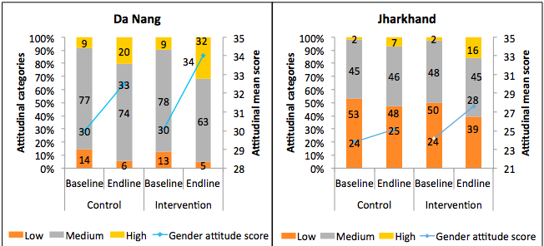
Focused programs shift attitude towards gender norms
Vietnam
India
Achyut et al, 2018, ICRW
Notes:
Net increase in mean score – Adj DID = 1.6 in Da Nang & 2 in Jharkhand
Adj DID for high score = 12% (Da Nang) & 8% (Jhar)
Change from moderate to high in Da Nang & low to moderate and high in Jhar
Who changed more in intervention schools – girls in Da Nang; Jhar – those from Khunti district, exposure to >60% sessions, having TV at home and follow Hindu religion

Slide 6
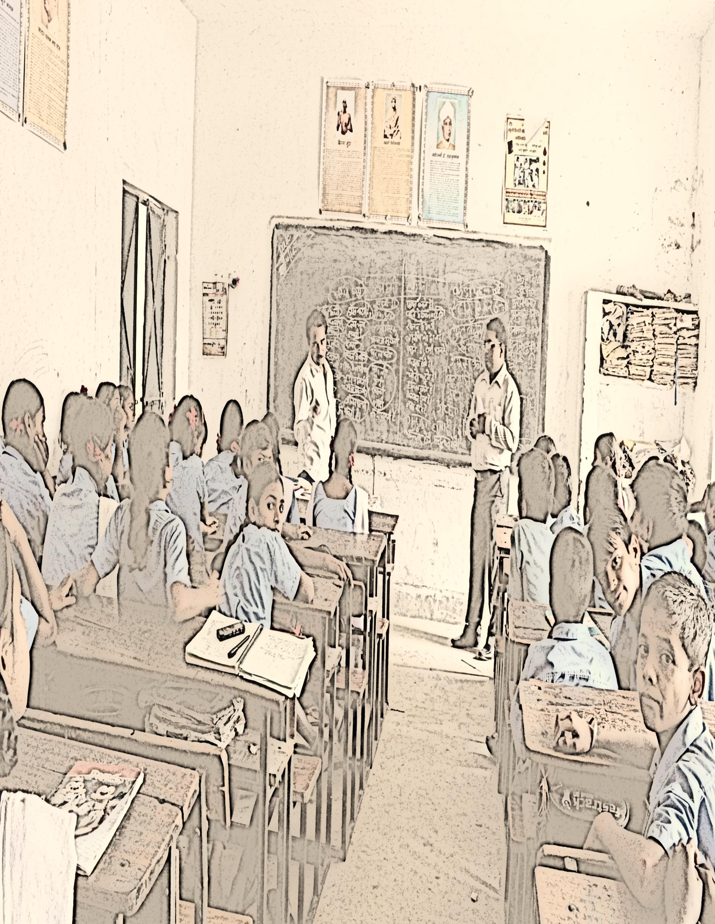
Through disruptions and collective reflections
Why do boys rape girls?
Why does child marriage happen ?
Isn’t physical punishment violence?
What do we do if someone touches us inappropriately?
Don’t I differentiate in work distribution?
Why violence while playing?
Why do boys and girls experience different body changes?
Do I share household responsibility?
Notes:
Example from GEMS:
Students to be able to raise questions shows that they feel safe and encouraged. This is also true for teachers… Collective reflection

Slide 7
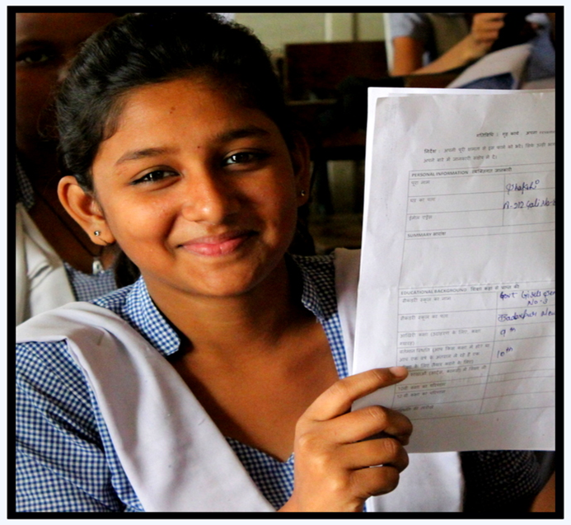
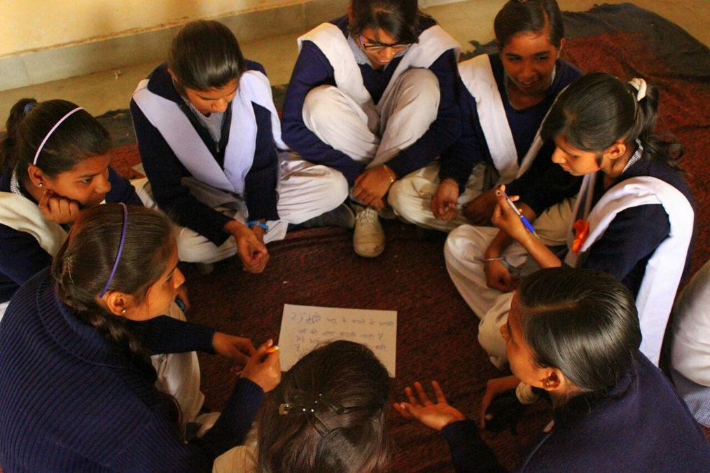
They create agency and aspirations
“The Self-Efficacy Module taught me that the qualities I admire in other people, I can develop too. For me, that was a big realization. I don’t always have to look to others to be leaders. I can also demonstrate personal leadership.”
--- Class XII Student
“When I was growing up, I wanted to be a teacher like society expects us to be – because it is safe. Then I thought I would be a doctor, because my father said that it would be a good profession. But when we learnt about Gendered Roles and Expectations and Goal Setting in PAGE, I realized that I want to be a NASA scientist. That is what I will work towards. Not what the society wants or what my family wants, but what I want.”
--- Class X Student
Notes:
This is from PAGE:
We have received positive feedback from the girls, parents and teachers. I am going to read one of the quotes from a PAGE girl.
The teachers feel that the girls are more focused about their futures
And the parents have said that the program provides girls with an opportunity to feel more in control/ empowered.

Slide 8
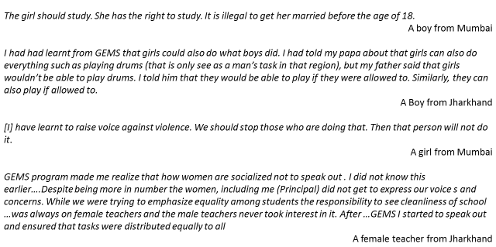
And critical voices….

Slide 9
Gender norm changes are highly contextual and negotiated
While some norms change, others are difficult to change especially that are deeply embedded
The ones that changed
A wife should always obey her husband
Violence against girls are perpetrated by strangers
If a girl says no, she means yes
The ones that were difficult to change
A woman’s primary role is home making and child care.
A girl should have reasons to go in public places
Boys and young men negotiate learnings about norm change in their specific realities
For instance – anxieties around compromised masculinity’ ‘what will my peers say, what will my neighbors think’. Brothers for example didn’t want to be seen as supporting their sisters in sports involving pubic open spaces. They were passive supporters.
Boys and young men often wrestle with women’s and girls’ mobility.
They identified various security and safety considerations for justifying men’s control over their behavior. This is an area that needs greater attention. (Parivartan)
There is an increased recognition and improved articulation on violence and its consequences but adolescent boys and young men weigh the conditions and risks before by-stander intervention.
Will they accompany sisters or daughters to participate in public sports? Or
Will they intervene in schools when witness discrimination
KEY LEARNINGS
Notes:
Attitudes that are likely to change through interventions (GEMS)
For women, taking care of the house and children should be more important than her work.
The traditional view that a man is the head of the family and responsible for providing economically for the family is still correct.
Men should have more rights to make household decisions.
Only men should work outside home.
Attitudes that are resistant to change (GEMS)
Girls should be allowed to decide when they want to marry.
Girls should have a say in choosing their groom for marriage.
A girl should have a right over parents property.
Boys are violent by nature.
Violence against women is acceptable in some situations.

Slide 10
And efforts to change them must permeate informal spaces…Blur public and private
Engage with young men and boys as agent of change —
“I discuss the topics that are in the modules ..but not everything together. I give them small doses. This will help them understand where my thinking is coming from.… if I talk everything at the same time and it becomes an overdose then they would ask me to shut up.” (An adolescent boy participant from Parivartan Plus).
Target informal spaces not just formal spaces —
Dliberate, reflective dialogues with men and boys in the informal spaces within school, family and community.
Proactive family engagement and positive spin is what works —
Elevated levels of aspirations on the part of mentors and their mothers was a strong driver of the bargaining in favor of mobility within and beyond the family.
Build collective agency and negotiation spaces and skills —
Reference group, a critical mass, that can help to navigate what is ‘acceptable’, collective agency as a first step to individual agency. Nurture careful, strategic and gradual negotiation in daily interactions thus opening scope for dialogue.

Slide 11
Thank you! and deep appreciation to all our partners including young women and men – our fellow travellers in this journey of change ….and not a time-bound project

